Slide 1


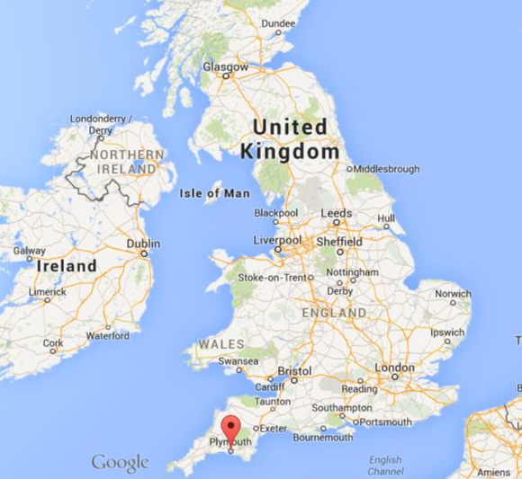
Catheter Ablation for Atrial Fibrillation
Dr Guy Haywood
Consultant Cardiologist and
Cardiac Electrophysiologist,
Plymouth, UK
Disclosures:
University Hospitals Plymouth holds intellectual property related to catheter development and oesophageal pacing method. Inventor - G Haywood
Nov 2025 update

Slide 2
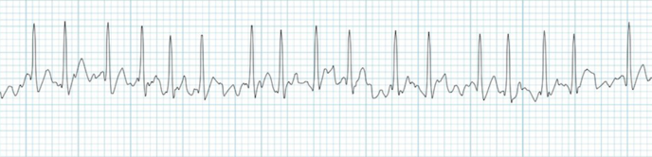
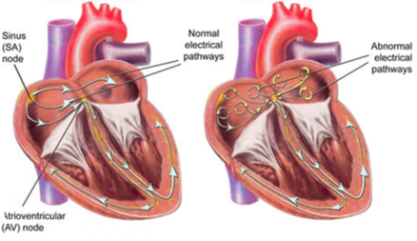


Atrial Fibrillation
The commonest pathological arrhythmia in the world
Caused by disordered electrical activity in the Atria
2 or more simultaneous interacting circuits required for AF
Normal Heart Rhythm
Atrial Fibrillation

Slide 3
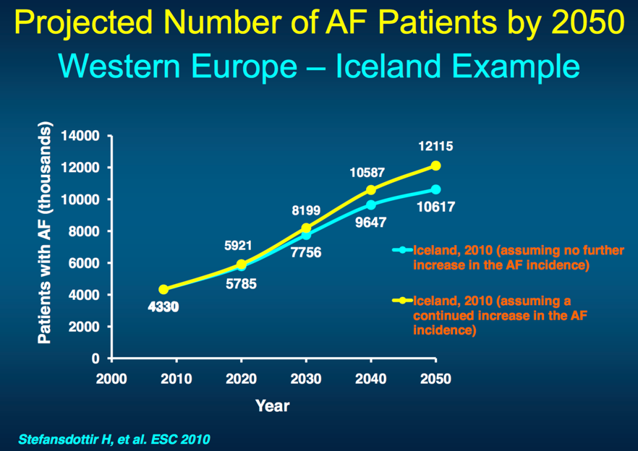
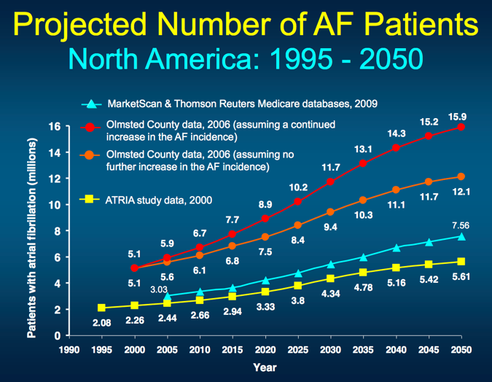
Atrial Fibrillation will double in the population worldwide by 2050
Atrial Fibrillation
1 – 1.5% of the world population affected
1 in 4 people aged 40 or older will develop AF

Slide 4
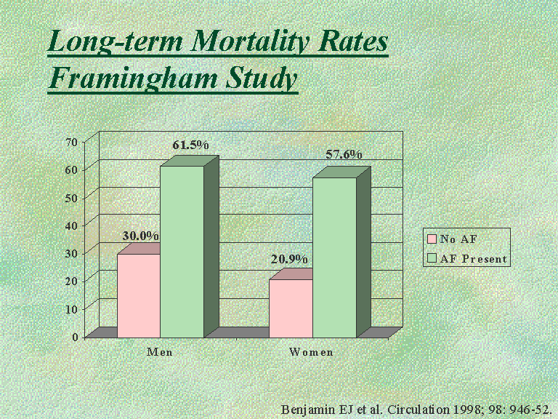
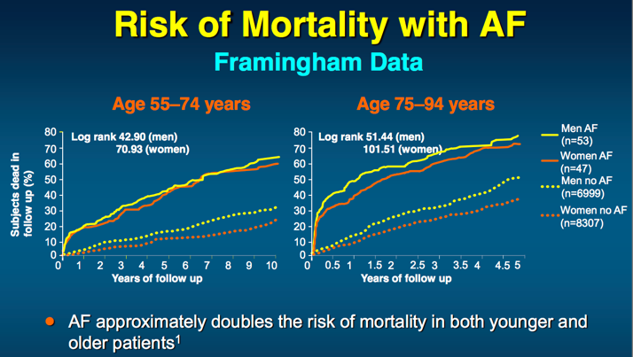
Atrial Fibrillation Doubles Mortality in all age groups
5 x risk of stroke
3 x risk of heart failure
2 x higher rate of hospitalization
3 x more likely to have multiple hospital admissions
(American Heart Association)

Slide 5
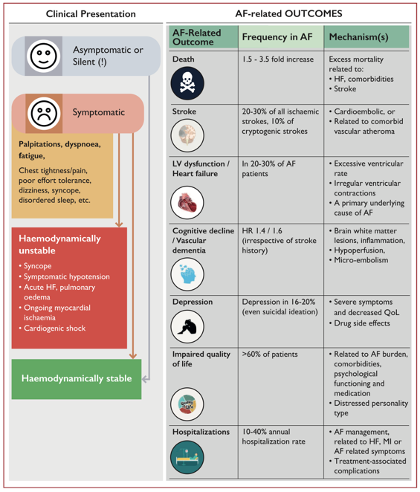

Atrial Fibrillation causes distressing symptoms in the majority of patients and has major impact on health and quality of life
Shortness of breath
Palpitations (distressing awareness of fast/powerful/irregular heartbeat)
Dizziness lightheadedness
Chest pain / discomfort
Fatigue
Anxiety and depression
Drug side effects
European Society of Cardiology
Atrial Fibrillation Guidelines 2020

Slide 6
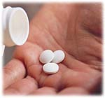
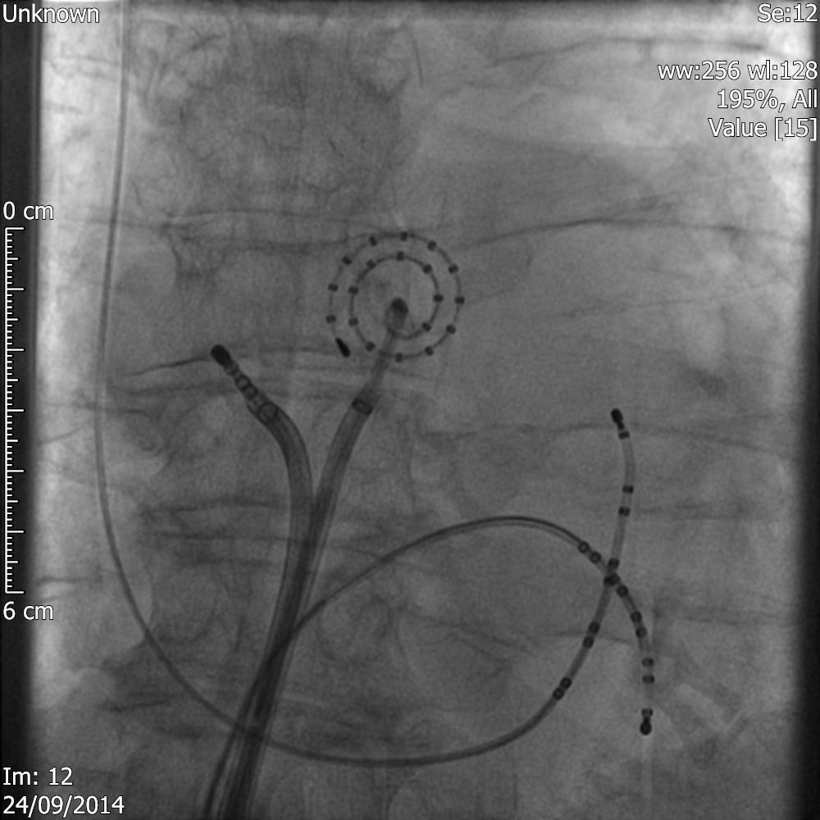
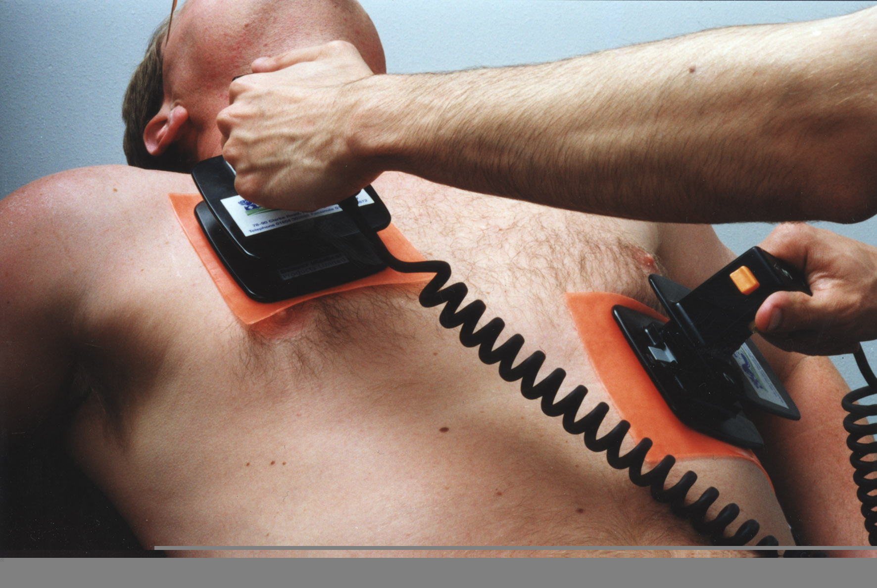
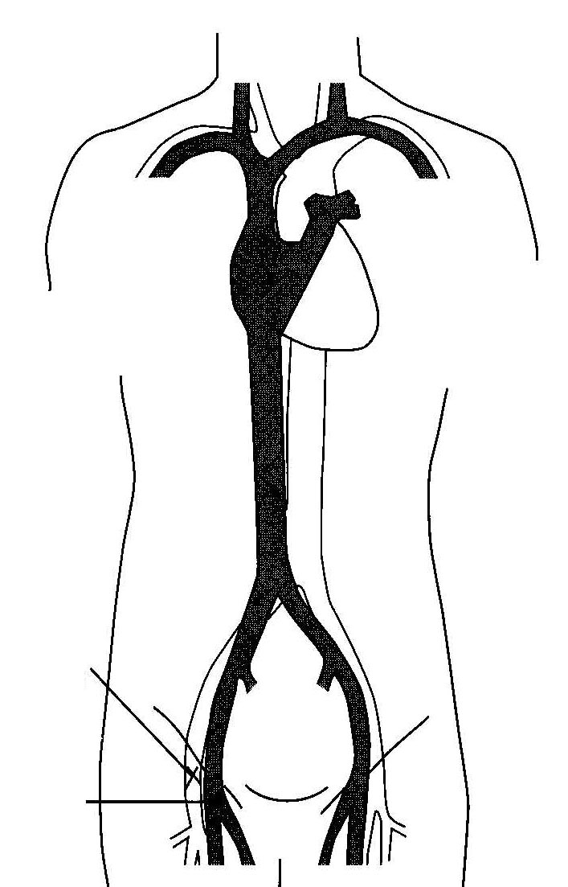
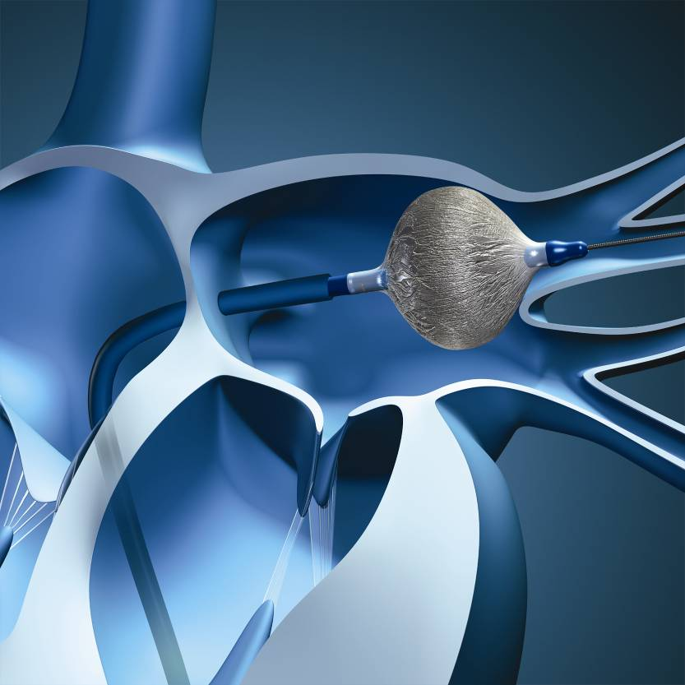
AF Treatments
ABLATION
DRUGS
mapping catheter
ablation catheter
Drug therapy, works well for a minority of patients, but remains relatively ineffective and can result in side effects
Recording and
pacing electrodes
DCCV
Subclavian
Vein
Cryoballoon
Ablation
DC Cardioversion is a temporary treatment for patients with persistent AF – returns around 85% to normal sinus rhythm, but up to 70% revert to AF within 1 year
Femoral
Artery
Drugs
Femoral
Vein

Slide 7

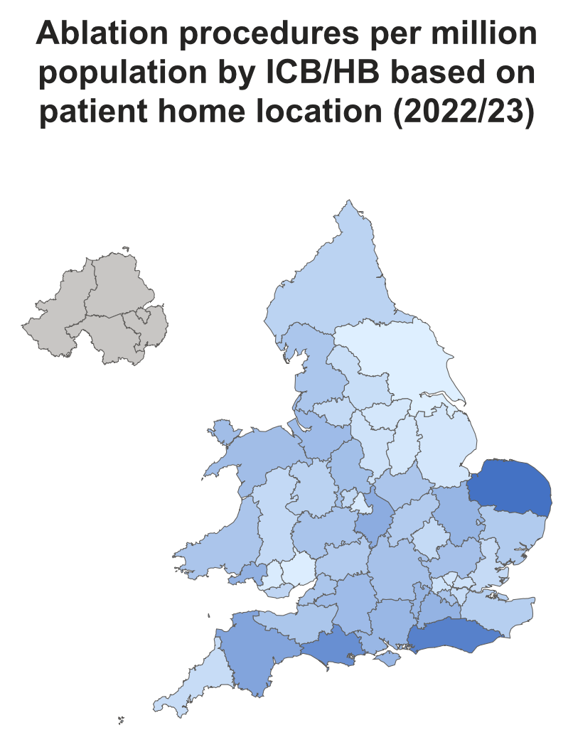

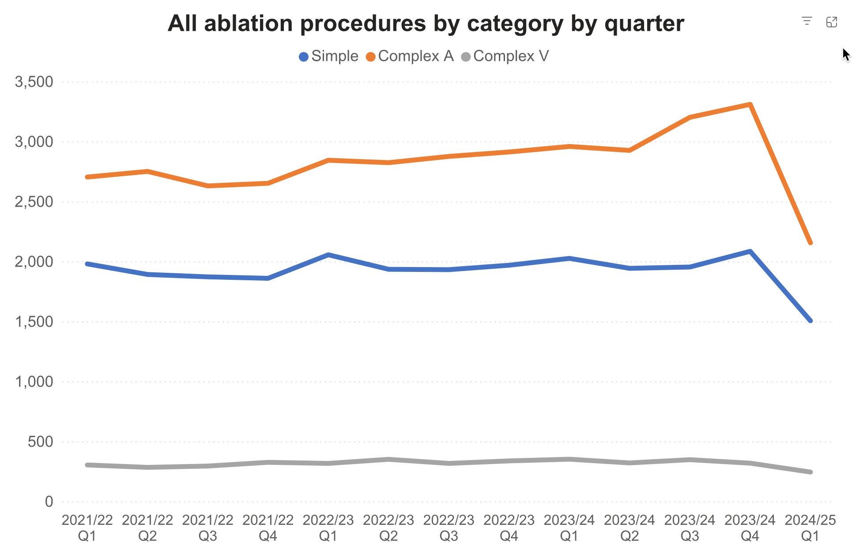
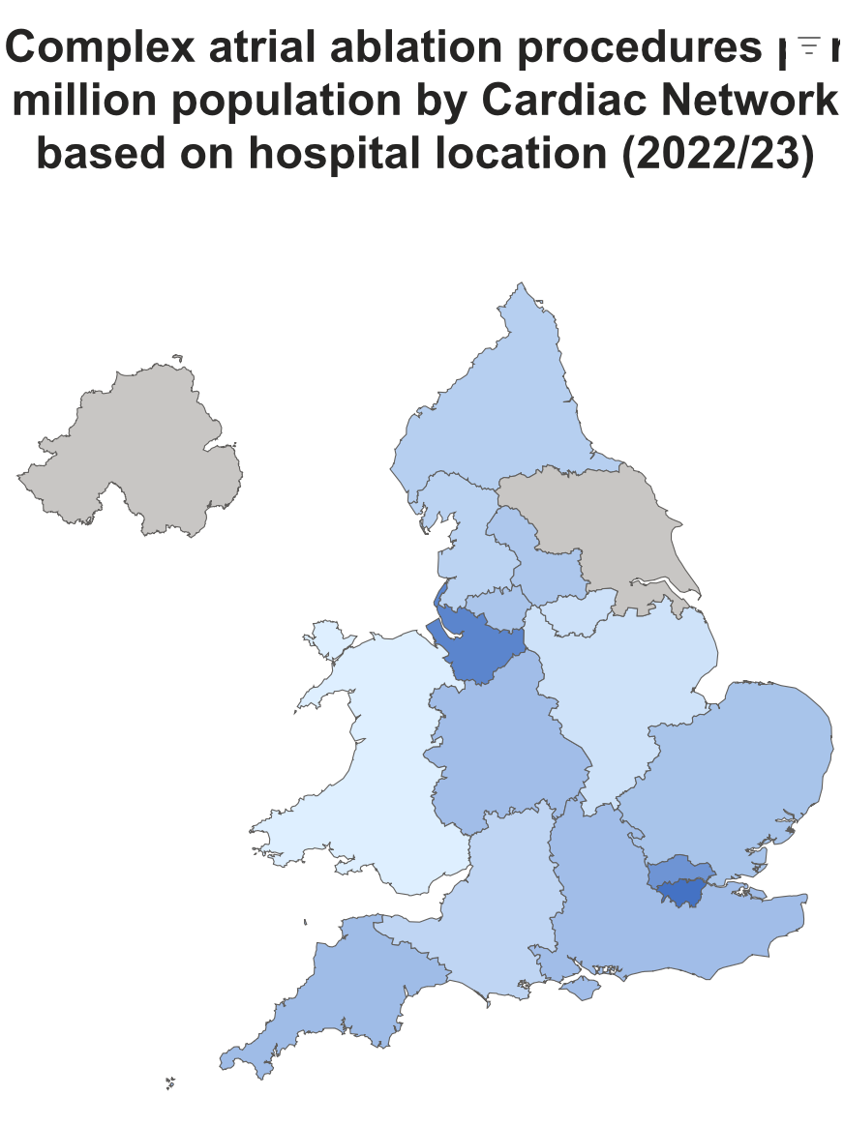
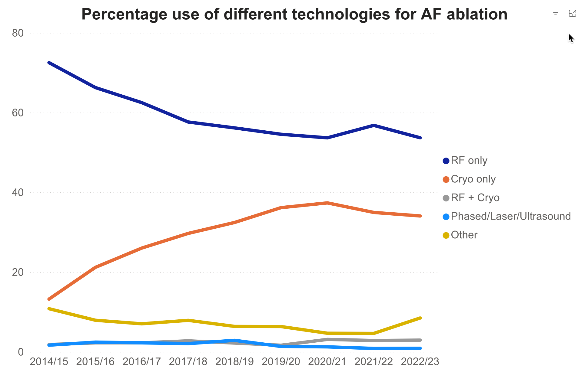
2024 Report
(Complex Atrial)
Ablation numbers for 2024
projected from last complete
quarter data:
63pmp to
468pmp
Simple 8,336
Complex A 13,236
Complex V 1,272
Total 22,844
Ablation Modality Estimates for 2024:
RF
RF estimated 45%
Cryo
Cryoballoon AF ablation 40% of all cases
PFA
PFA estimated 13%
Numbers of Ablations in UK

Slide 8
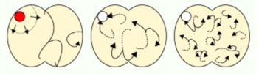
How effective are current AF Therapies?
Three Types of AF
Paroxysmal
Persistent
Longstanding
Persistent
Easiest to treat
Hardest to treat
Paroxysmal (reverting to normal sinus rhythm within 1 week)
Persistent (episodes lasting longer than 1 week or needing DCCV)
Longstanding Persistent (continuous AF for more than 1 year)

Slide 9
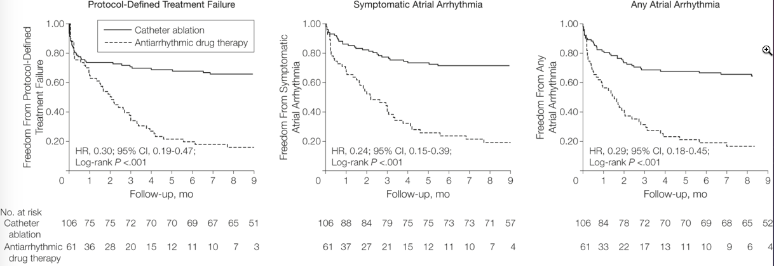
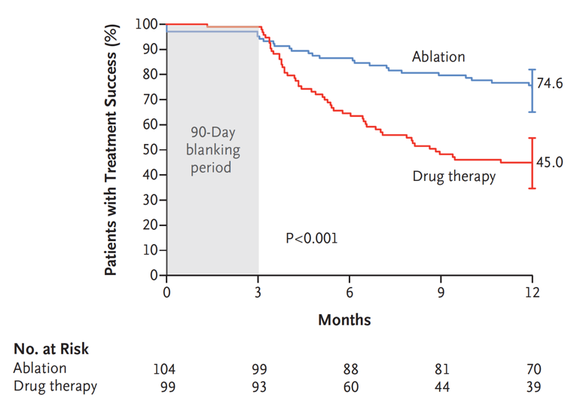

Ablation versus Drug Therapy for PAF
Only 19% remained free of recurrent AF with drugs alone
70% remained free of recurrent AF with ablation
NEJM 2020. doi: 10.1056/NEJMoa2029554
Patients still symptomatic after b blocker
Randomized to Ablation or Anti-arrhythmic drugs

Slide 10
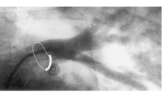
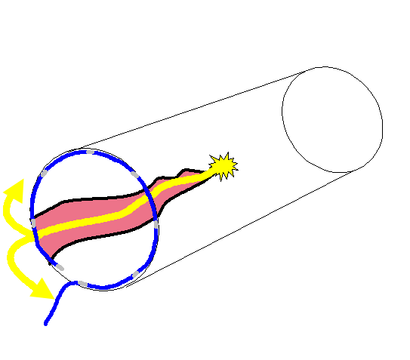
‘Pulmonary vein triggers are responsible for initiating Atrial Fibrillation’
History of Ablation for Atrial Fibrillation
1st surgical ‘Cox Maze’ procedure 1987
Clincally effective, but too complex for wider uptake
1987 to 2000 - 2 largest centres in USA 567 procedures total
Haïssaguerre M et al NEJM 1998 339:659-666
Catheter ablation for atrial fibrillation
2024 – over 11,000 procedures in the UK per annum
Notes:
This is done by inserting a ring shaped catheter into the vein and using it to identify the channel of tissue that conducts the electrical activity from the source of the ectopic abnormal beats into the left atrium. By identifying which part of the ring shaped catheter is activating it is then possible to direct RF to that part therefore disconnecting the ectopic source from the atrium and thereby eliminating the atrial fibrillation. On the left is an X-ray image of a vein into which X-ray dye has been injected which is running from the lung into the atrium via the vein. On the right is a diagram of the ring shaped catheter inserted into the vein in order to identify the location of the tissue connecting the ectopic source to the atrium. However this technique only works for AF that is caused by ectopic beats and stops on its own if the ectopics are removed. Treating AF that persists is more difficult.

Slide 11
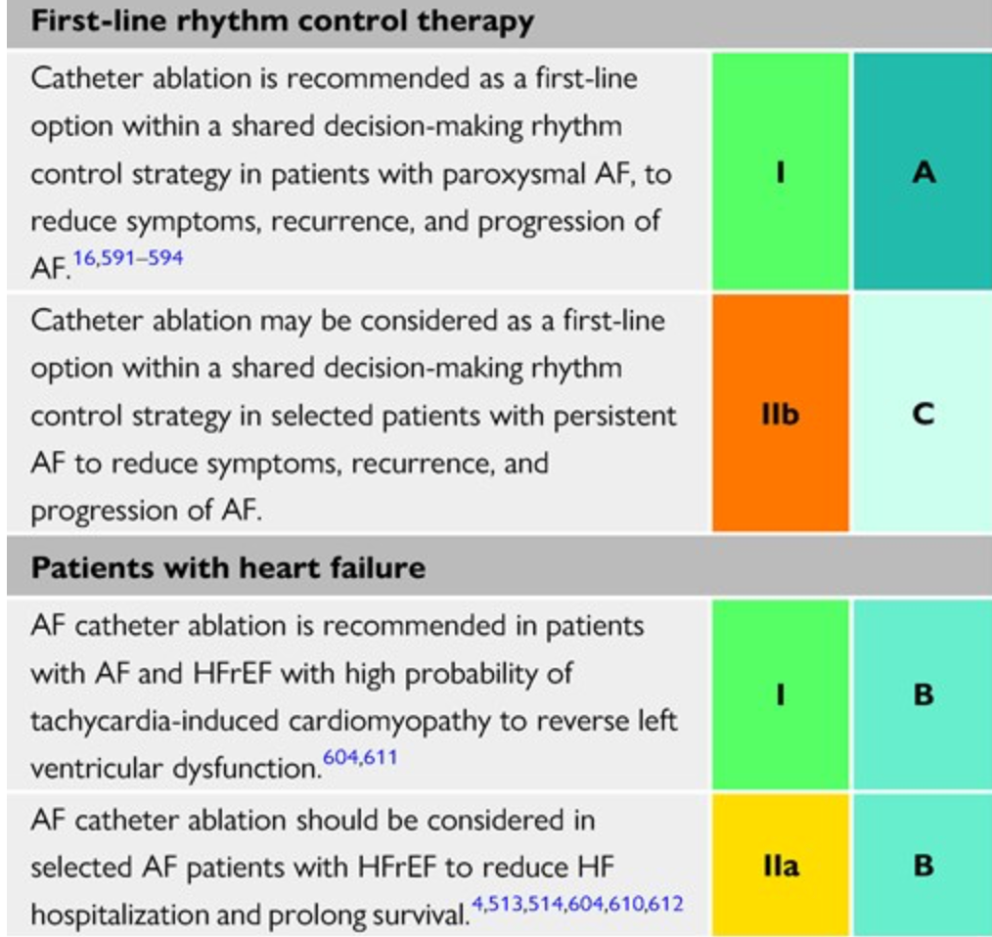
European Society of Cardiology 2024
Guidance on Catheter Ablation for Atrial Fibrillation
The latest guidelines give a ‘Class 1’ recommendation for AF ablation
in patients who are still getting symptomatic atrial fibrillation after an
antiarrhythmic drug or when AF has caused features of heart failure

Slide 12
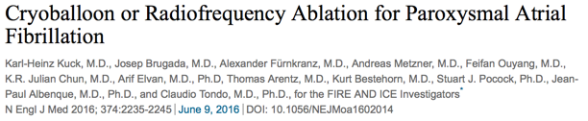
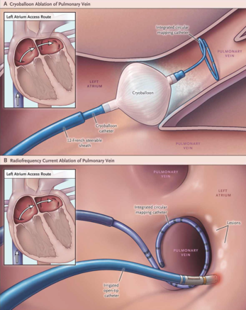
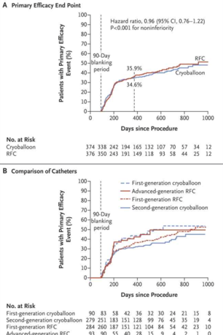
Current Catheter Ablation Methodology Paroxysmal Atrial Fibrillation – SIMPLEST TO TREAT
Key Published Paper
769 patients
Primary endpoint: recurrence of atrial fibrillation), atrial flutter or atrial tachycardia, prescription of antiarrhythmic drugs (class I or III), or repeat ablation
Weekly trans-telephonic ECG, ECG at time of symptoms, 24 Hr ECG at 3,6,12 months
65.4% Cryoballoon cases free of arrhythmia at 1 year
64.1% Radiofrequency cases free of arrhythmia at 1 year
‘Fire and Ice’ Trial

Slide 13
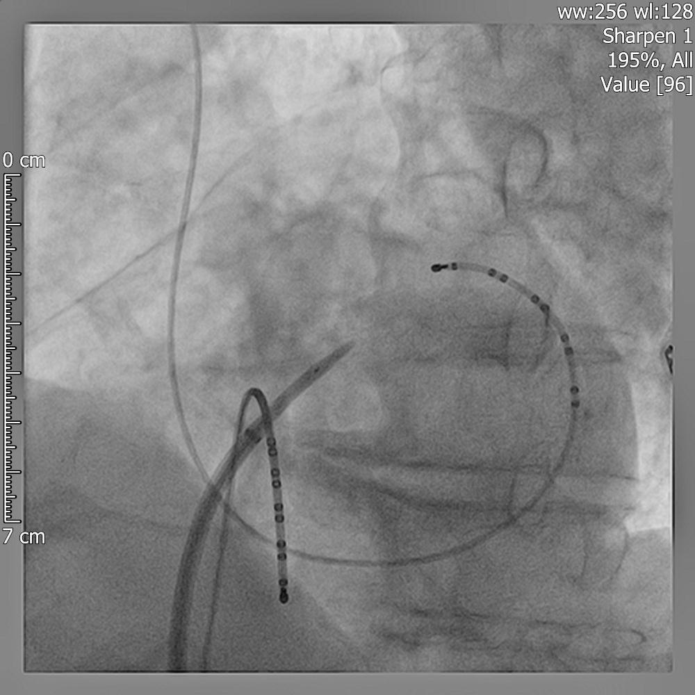
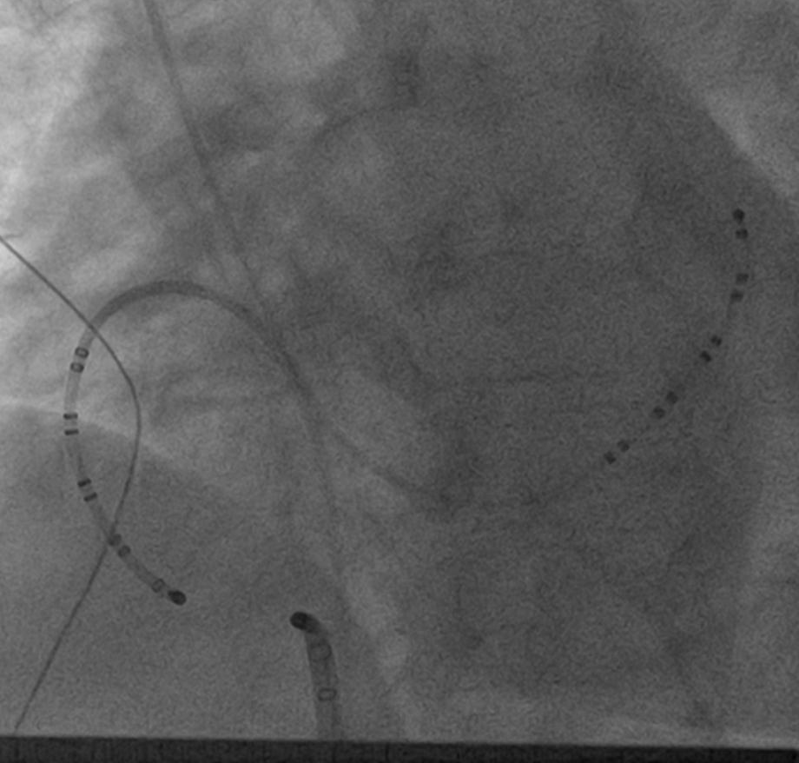
Radiofrequency AF Ablation Instrumentation
Left Atrial Ablation
Transeptal Puncture to
access left atrium
mapping catheter
ablation catheter
Subclavian
Vein
Recording and
pacing electrodes
Femoral
Artery
Femoral
Vein
Right Atrial Ablation
Cavotricuspid Isthmus line for
Typical Atrial Flutter

Slide 14
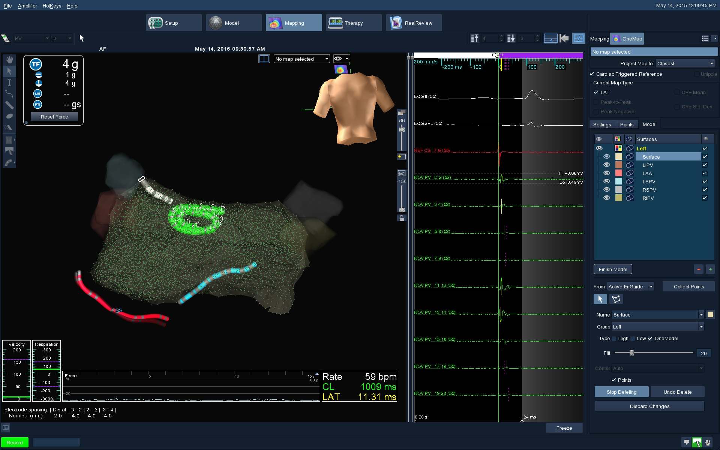
Precision 3 D Mapping System

Slide 15
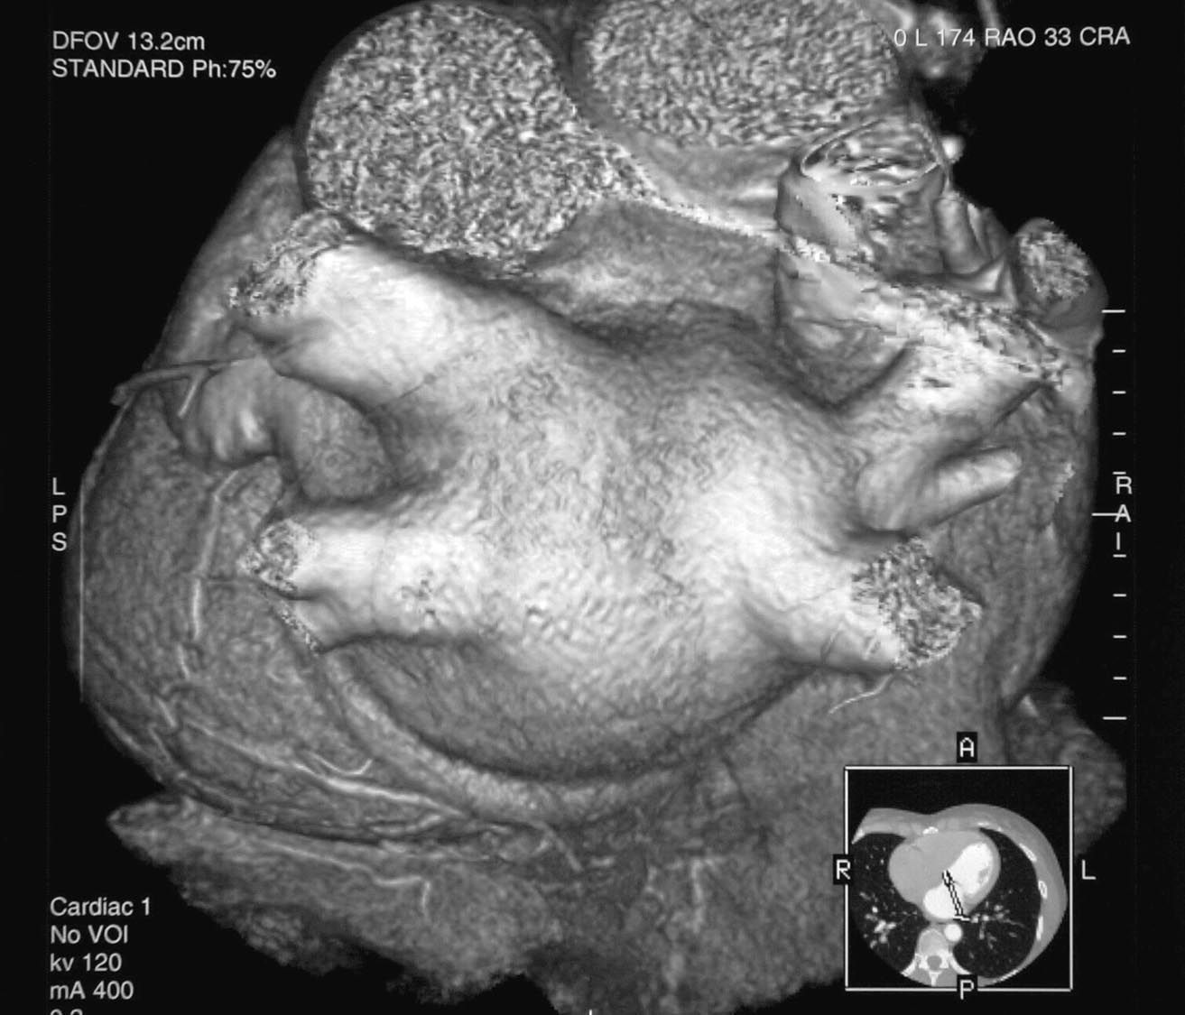
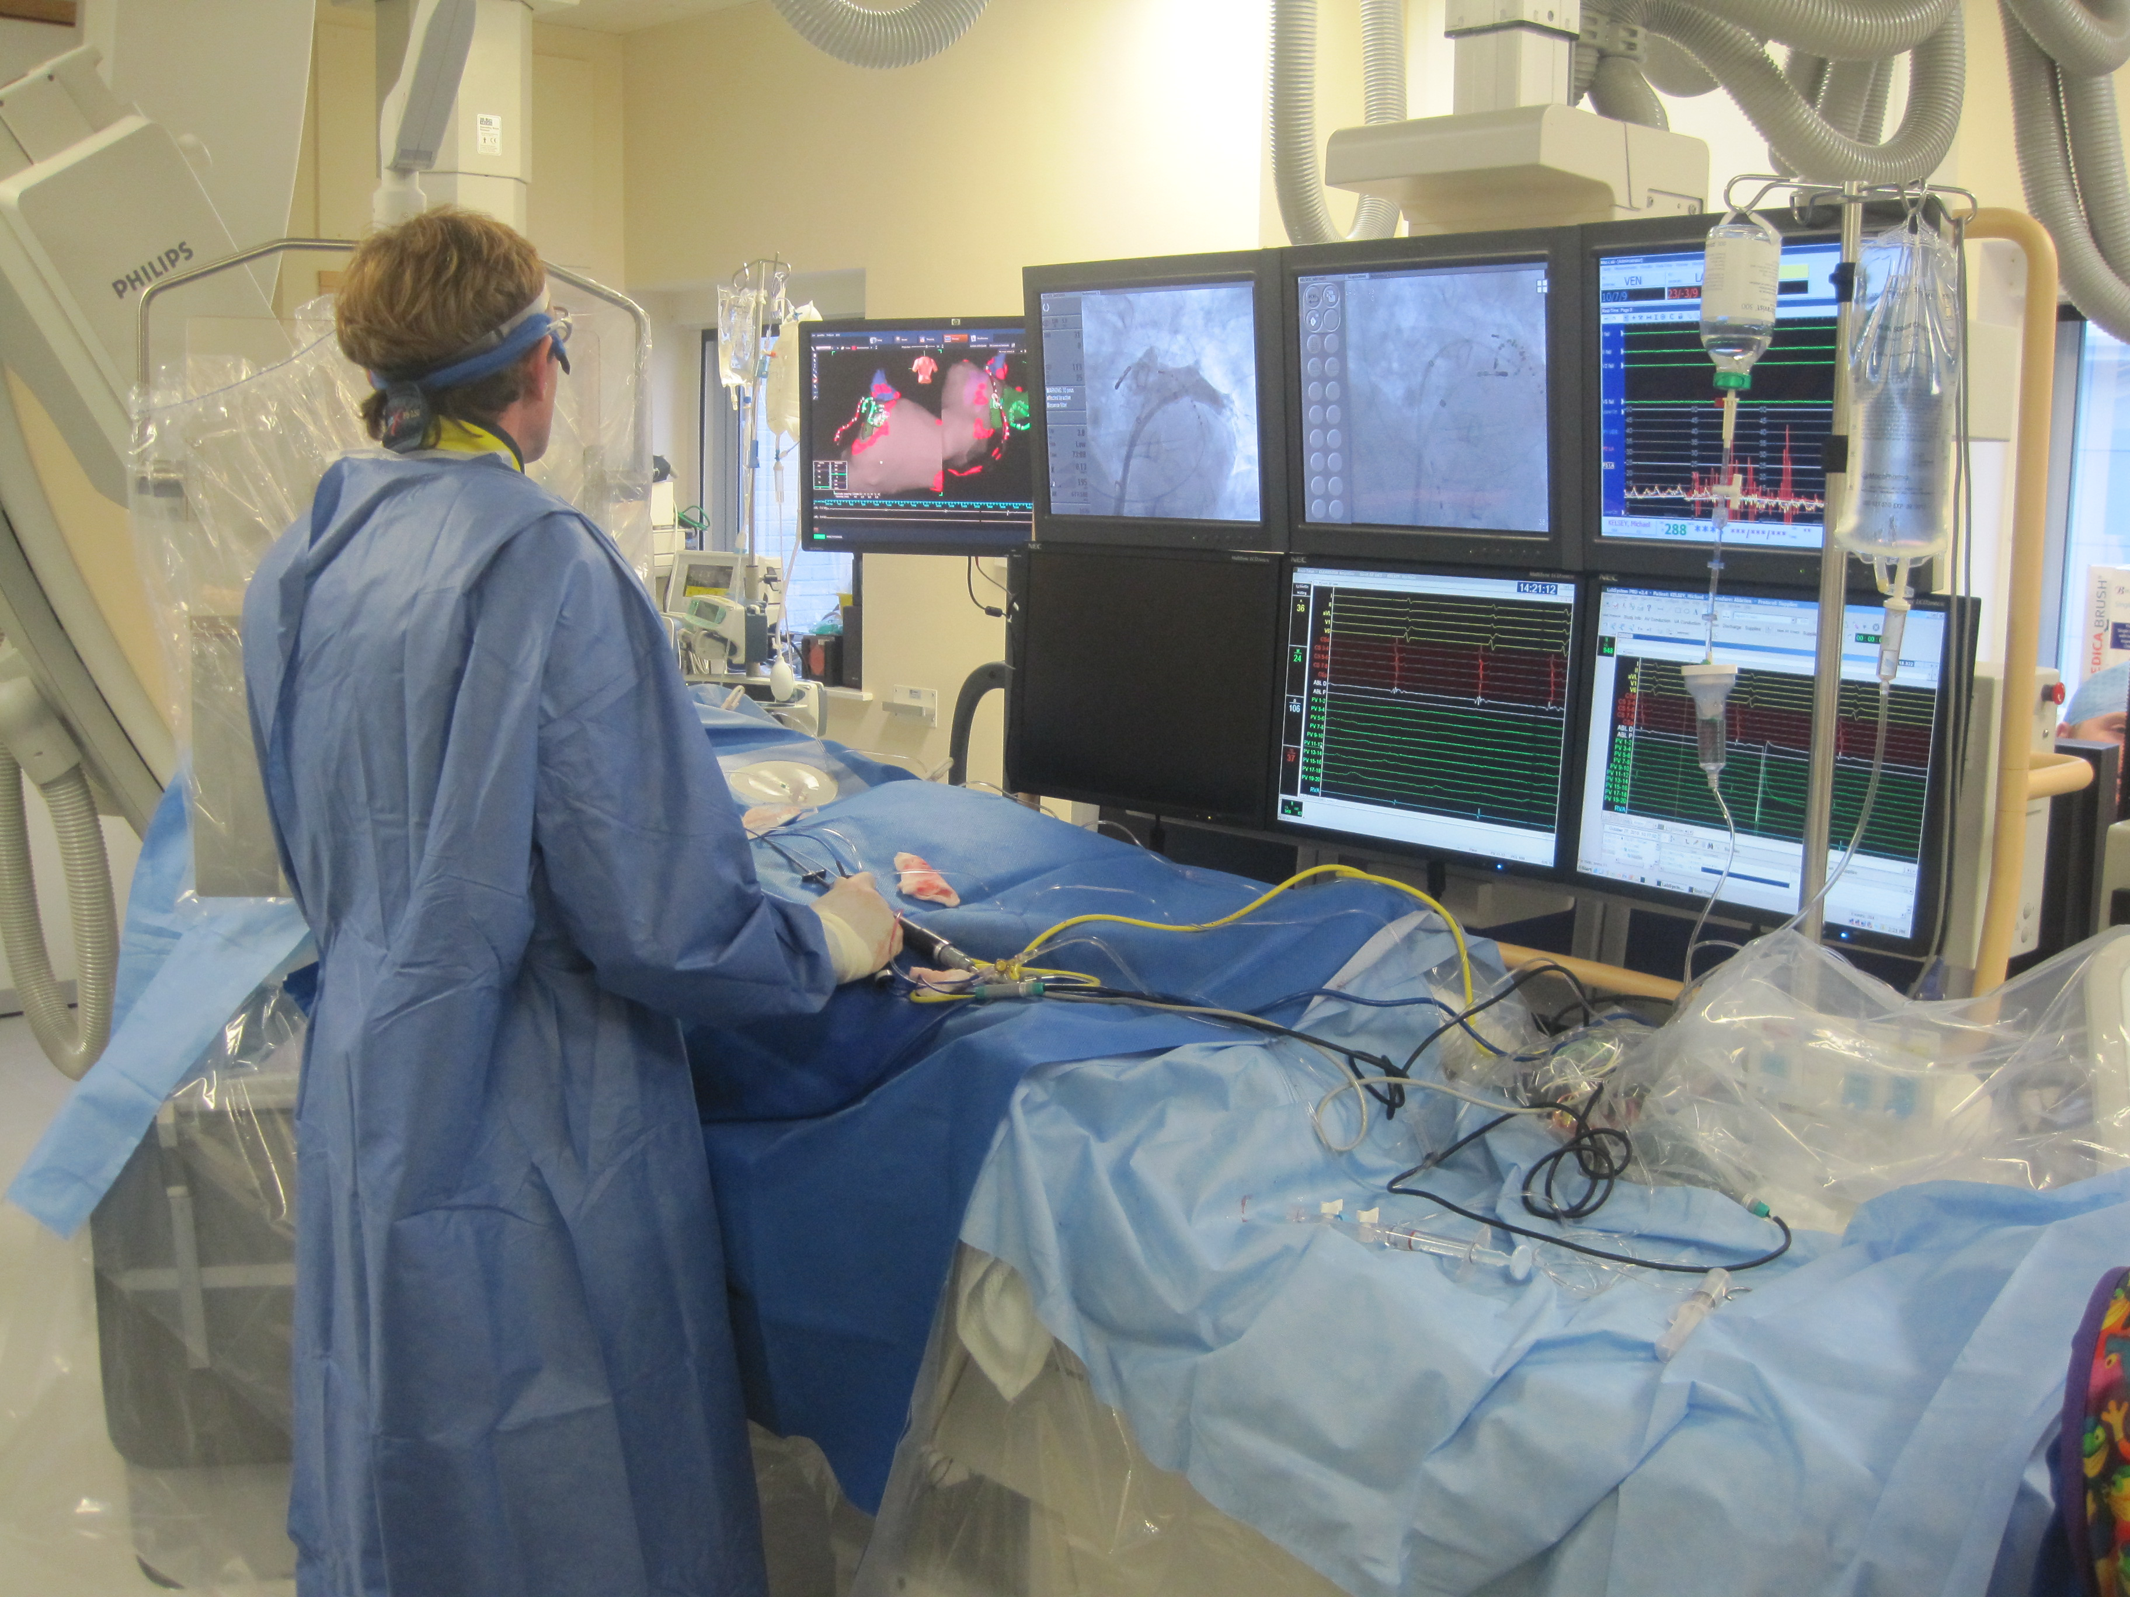
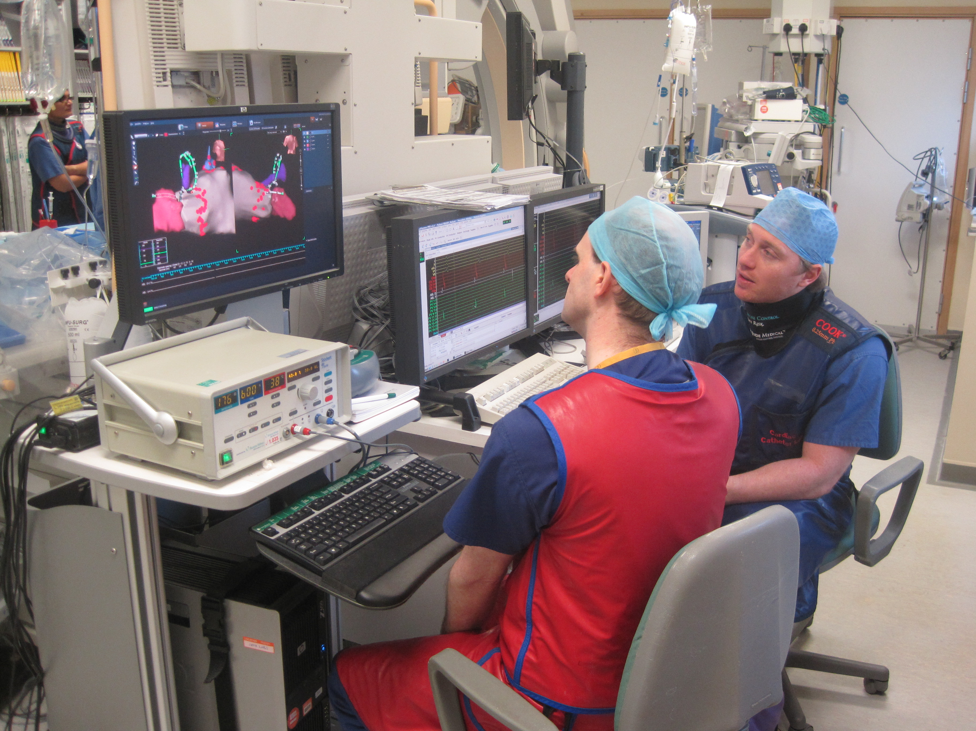
An electrical ‘fence’ is formed around the areas of the heart where the triggers causing atrial fibrillation are most commonly sited. This is done by a series of point-by-point heat applications. Any gaps in the line can result in the trouble getting out again after the muscle in the gap recovers conduction.
Pulmonary Vein Isolation

Slide 16
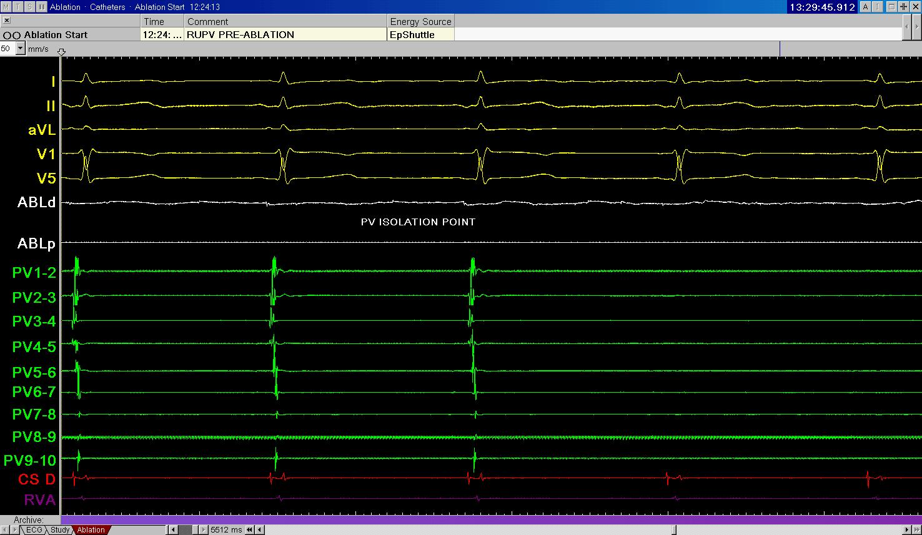
Electrical Isolation of a Pulmonary Vein
Pulmonary V
‘Fenced off’
from rest of
Atrium
Atrial p wave
Still entering
Pulmonary V
Signals from the
Mapping Catheter
inside the
Pumonary Vein
When isolated
P waves can’t get in
PV triggers can’t get out

Slide 17
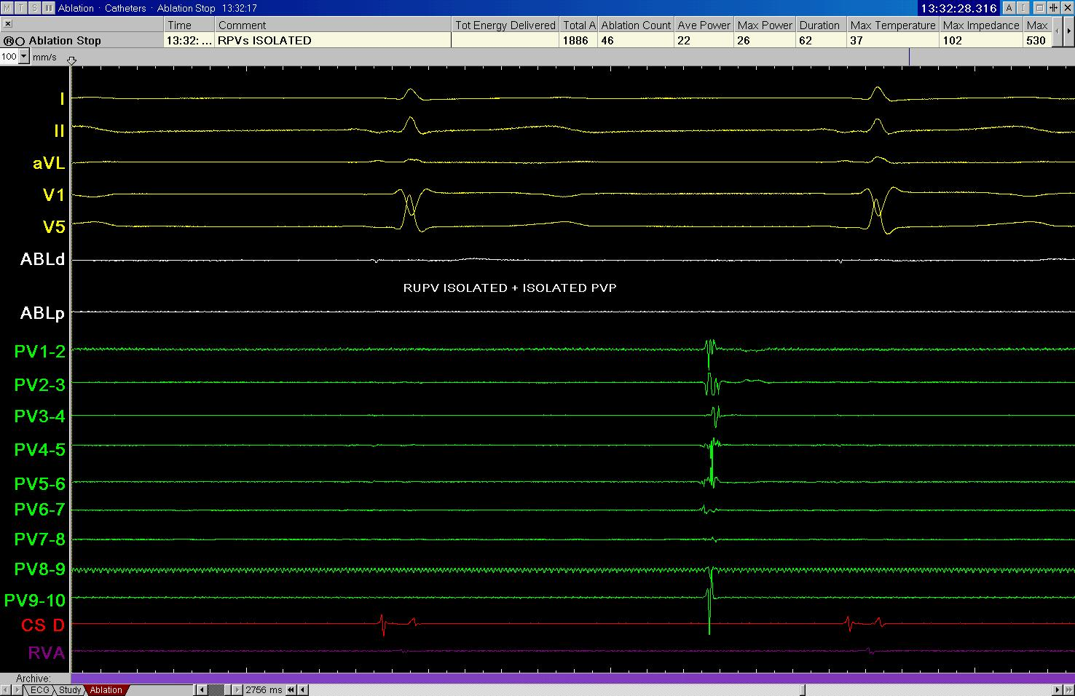
Isolated Pulmonary Vein Potential
A trigger fires in the pulmonary vein
but does not get out in to the atrium
and Sinus Rhythm continues undisturbed

Slide 18
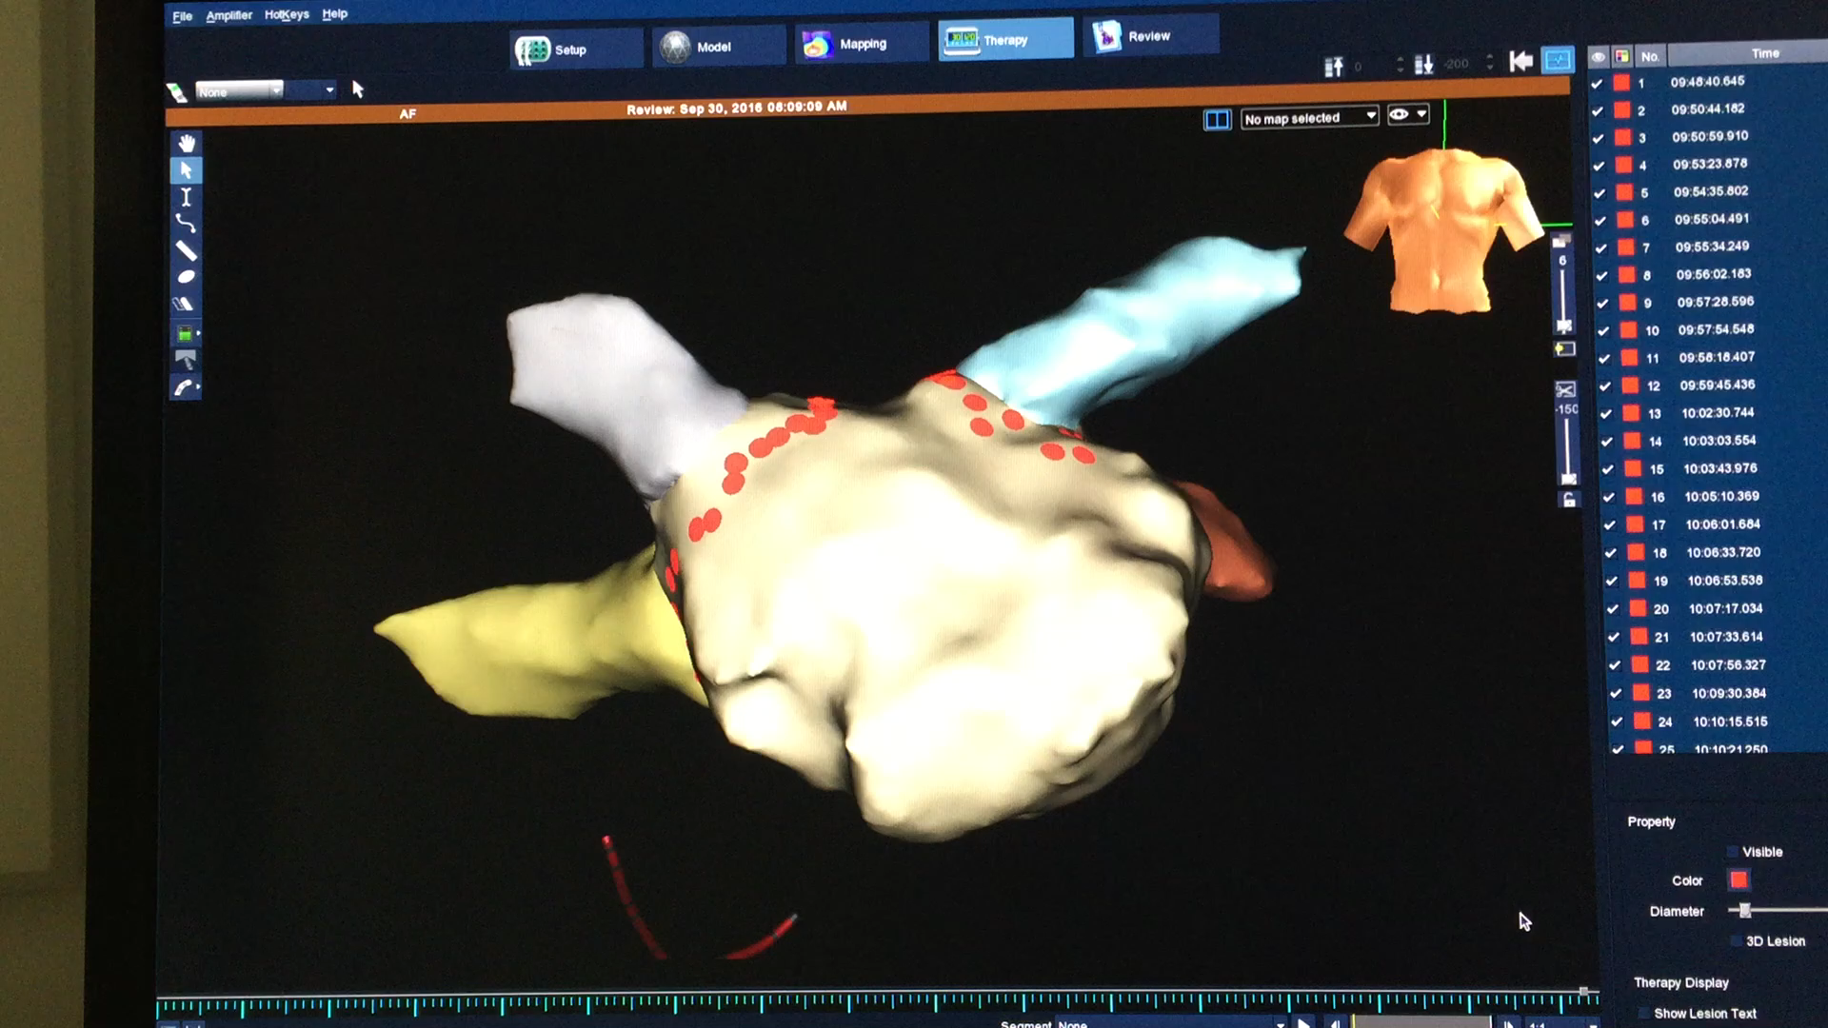
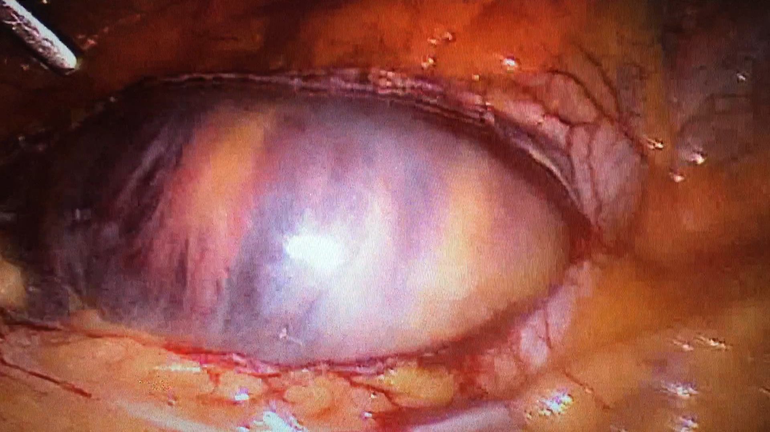
Standard Radiofrequency Pulmonary Vein Isolation
Around 60 - 100 individual points are required to achieve pulmonary vein isolation
The catheter tip has to be kept in a stable position in a beating heart for around 15-30 seconds minimum per point
Greatest problem RECONNECTION – failure to create continuous, transmural, permanent lines of block

Slide 19
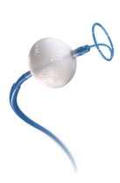
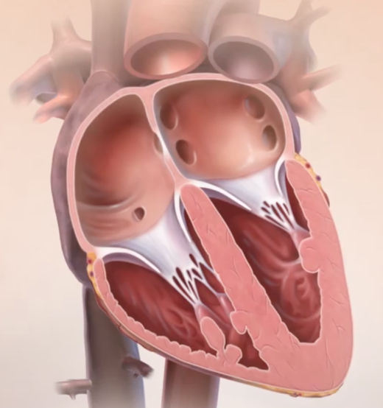
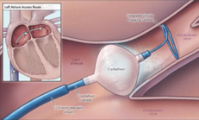
Cryoballoon Pulmonary Vein Isolation? 1) CRYOBALLOON IN PAROXYSMAL AND PERSISTENT AF
The electrically irritable cells that are the triggers for AF are mainly in the mouths of the pulmonary veins
The cryoballoon ‘fences off’ the triggers

Slide 20

Reconnection with Cryoballoon
Key Published Paper
84 pulmonary veins in 21 patients ablated with 28 mm Arctic Front Advance Cryoballoon
All PVs isolated at the procedure
19/21 patients had repeat EP study at 3 months
79% of patients still had isolation in all 4 veins at the follow-up study (91% of all veins remained isolated)

Slide 21
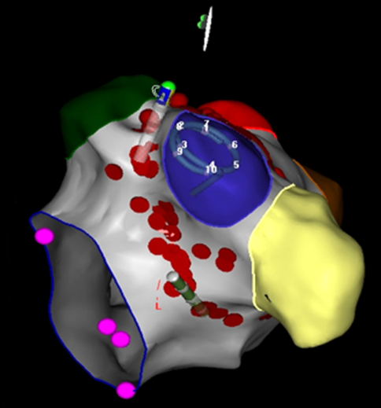
PRESSURE trial (UK multicentre) (Mandatory 2nd catheter procedure v 2nd procedure only for documented AF recurrences)
Radiofrequency Ablation
Gupta D et al. JACC Clin Electrophysiol. 2017 Jun;3(6):602-611
Contact force sensing sensing RF ablation catheters
80 patients randomised at end of first AF ablation for PAF to:
Group A) 2nd procedure at 2 months or Group B) further ablation only if symptoms with documented AF
Group A - 62% reconnected at restudy – gaps closed with further ablation
Arrhythmia Free at 1 year: Group A 82.5% v Group B 57%
GH Cryoballoon 2025 audit – only 25% of re-do patients found to have reconnected

Slide 22
Plymouth Cryoballoon Results
6/10/2025 Independent audit of all AF patients treated by Dr Guy Haywood
Latest cryoballoon technology
All patients treated 2015 – 2022 with 2 years of follow up after the latest patient in the cohort
Medtronic Arctic Front Advance
Cryoballoon System
Total number 176 patients with Atrial Fibrillation (AF)
85 PAF, 91 Pers AF
Age 63 [19 – 81]
Male 62%
Median LVEF 55 % [ 30 – 74%]
LA dilated in 50%

Slide 23
Understanding results: What is a failure?
By definition, >30 secs AF even if asymptomatic = AF ablation failure
Should we call a patient who has had continuous AF for over a year a failure if they have a day a year in AF after ablation?
Has a coronary stent procedure ‘failed’ if a patient reports an episode of chest discomfort after the procedure?
What is the best way of measuring the benefit to the patient?

Slide 24
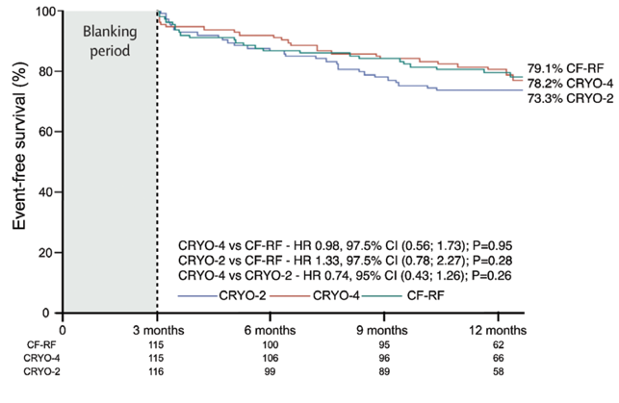
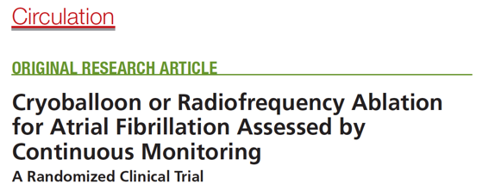
GH Personal AF Ablation Results for Paroxysmal Atrial Fibrillation (2025 cryoballoon audit)
For Comparison
Total PAF Patients in audit = 85
2%(1)
Recent standard results reported in the scientific literature for the same cryoballoon system compared to latest RF ablation catheter technology
12 month success: 88%
98%(11)
Freedom from recurrence of any symptomatic atrial arrhythmia
24 month success: 85%
Recurrence severe enough to require re-do procedure = 7.6%
Andrade JG et al.
2% (1)
CIRCA-DOSE Trial

Slide 25
Progression from Paroxysmal to Persistent AFib
1.0
0.8
Without structural heart disease
0.6
Ratio in sinus rhythm
0.4
With structural heart disease
0.2
0
0
5
10
15
20
25
30
Paroxysmal AF onset
Follow-up (years)
Transformation of paroxysmal AFib to persistent AFib:
5.5% patients per year
Kato T, et al. Circ J (2004) 68: 568

Slide 26
GH Personal AF Ablation Results for Persistent Atrial Fibrillation (2025 cryoballoon audit)
12 month success: 75%
Total Pers AF Patients in audit = 91
2%(1)
24 month success: 59%
98%(11)
Recurrence severe enough to require re-do procedure = 28%

Slide 27
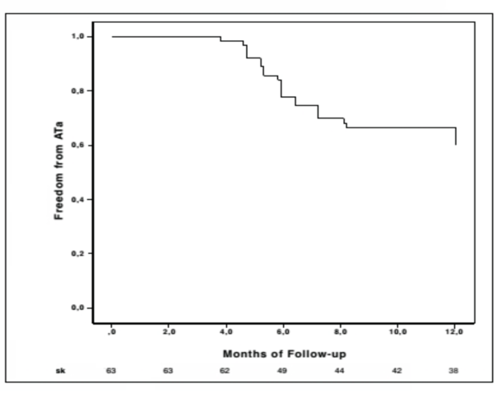
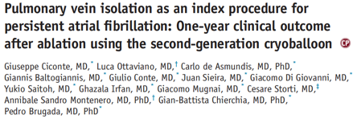
Cryo-balloon ablation for Early Persistent AF
For Comparison:
Heart Rhythm 2015;12:60–66
63 patients who had experienced persistent AF episodes
26 (41%) were in AF at the time of the procedure – none had AF > 1 year (AF persistency, months 7.2±2.1 )
Monitoring at 1, 3 , 6 and 12 months ECG and 24 hr tape only
Freedom from atrial tachycardias / AF post 3 month blanking period = 60% (After 1 year of follow up)
Complications: Femoral pseudoaneurysm 2/63 pts (3.2%) diaphragm paralysis 4/63 (6.4%)

Slide 28
GH Personal AF Ablation Results (2025 cryoballoon audit) - Complications
Total patients in audit = 190
No deaths, stroke, myocardial infarction, oesophageal fistula, or other major complication
Any complication: 4%

Slide 29
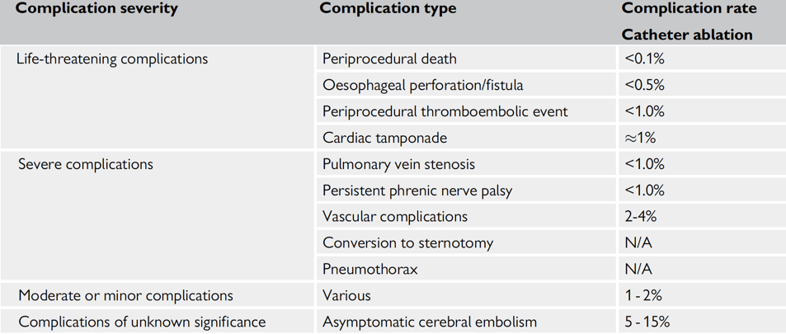
European Society of Cardiology AF Ablation 2020 - 7.2% in 2024 Guidelines
Complications – international results
Drug therapy complications
Anti-arrhythmic drug trials: Complications including side effects requiring withdrawal of drug 30%, Death 2.8% (Camm 2012)

Slide 30
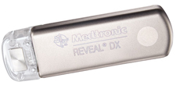
Comparing success rates post AF ablation procedures – reported success rates depend on how closely patients are monitored:
Discern AF JAMA Int Med 2013 Jan 28;173(2):149-56, Verma A et al.
50 patients 80% PAF
Medtronic Reveal implantable loop recorder in all patients
18 month follow up 3 monthly with symptom diaries and ECG and 48-hour Holter monitoring at the 3-, 6-, 9-, and 12-month visits
ICM data at each visit
Success defined as freedom from Atrial Fibrillation detected by any means
Success by symptoms alone = 58%
Success by symptoms ECG and 48 hour holter = 56%
Success by validated AF on ILR = 46%

Slide 31
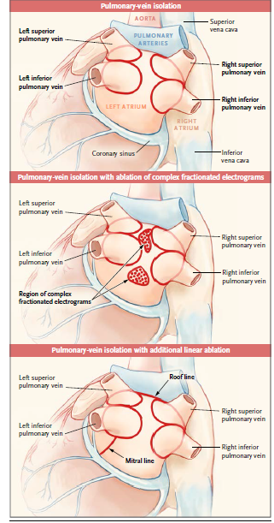
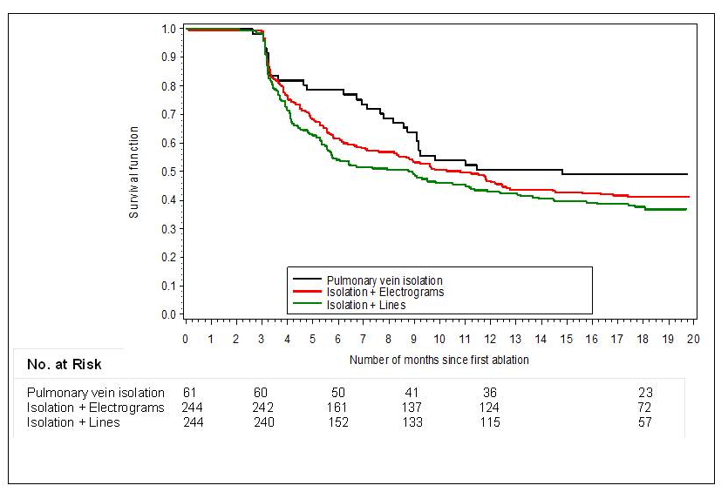
STAR AF II 18 month follow up of Persistent Atrial Fibrillation
Point by Point RF Ablation
589 patients all Persistent AF, 12 countries. Randomised. 18/12 follow-up
3 percutaneous ablation strategies
Posterior wall isolation not tested
Freedom from > 30 secs AF/AT on or off drugs at 18 months, 49% PVI, 41% PVI + CFAE, 37% PVI + mitral isthmus and roof lines
N Engl J Med 2015; 372:1812-1822

Slide 32
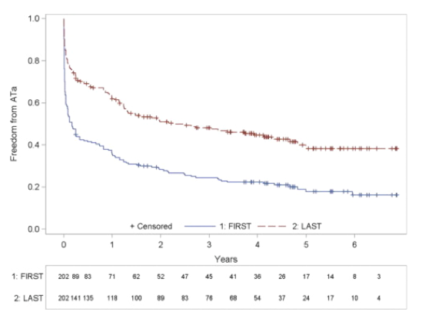
Kuck: 5 year follow up Long Standing Persistent AF Ablation (Most severe group)
J Am Coll Cardiol. 2012 Nov 6;60(19):1921-9
202 pts Persistent AF with continuous AF for 49±44 months (median 36 months)
PVI only at first ablation, PVI + Linear lesions and/or CFAE at subsequent ablations – Median 2 ablations (Range 1-5)
Complications : 4.7% of procedures
The Longer AF is present
the worse the results from Ablation
At 5 years of follow up success rate 20% from 1 procedure, 45% from multiple procedures.
Total AF duration - < 2yrs versus > 2yrs
76.5% vs. 42.2% (p = 0.033)

Slide 33
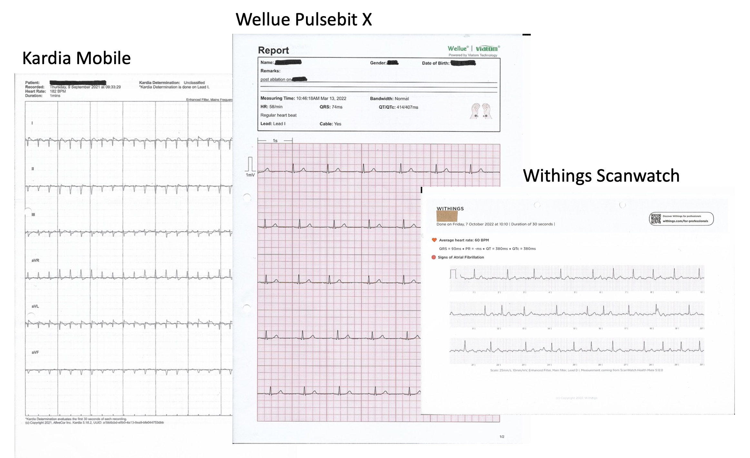










Diagnosing AF versus Other Arrhythmias
Apple Watch
Personal ECG
Recorders
Ability to capture brief arrhythmias
Monitoring of arrhythmia recurrence
Transmit to physician as email attachment
Volucke et al. Br J Cardiol 2023; 30: 128-31
Watches and Bluetooth smart phone devices allow patients to capture their ECG during symptoms to identify the arrhythmia

Slide 34





Recording an ECG with the Kardia Device
Obtaining a home ECG recording

Slide 35


Poor v. Good Quality ECG Traces
Both feet on floor
Back and head resting on chair
Forearms resting on table or lap
Moistened Finger-tips / Wrist
Best Approach:
Practise getting clean tracings during normal rhythm
When a typical attack occurs, duplicate this method
Useful to ask patient to record an ECG when feeling normal as well as when feeling arrhythmia
Obtaining good quality ECG recordings during arrhythmias

Slide 36





Comparing different ablation techniques for PAF
Clinical Efficacy of FARAPULSE v. RF and CRYO PVI
ADVENT
% AF Burden derived from 72 hour ECGs at 6 and 12 months and weekly trans-telephonic monitoring NOT ILRs
Durability
APHRS
Sept 2024
Nair et al.
Skin to skin Procedure Time 36 +/- 6 min, No complications
Pulsed Field Ablation is a new energy source which
is now becoming established as a good alternative to
Radiofrequency and Cryoballoon Ablation for AF

Slide 37


Alternative ‘palliative’ approach
Ablate and Pace
AV node Ablation

Slide 38

Ablate and Pace Outcomes
Wood MA Meta analysis Circulation 2000 101 1138-44

Slide 39


Improved Event-Free Survival? Before the randomized trials:
Outcome after catheter ablation of atrial fibrillation (AF) compared with medical treatment in the Euro Heart Survey and age and gender matched controls without AF in the general population
CHADS2
EuroHeart 1.6±1.2
Ablation 0.7±0.9 (predicted ~ 2.0%)
64% off OACs
Hunter R J et al. Heart 2012;98:48-53
Non-randomised

Slide 40




Randomized Trials:
Does AF catheter ablation reduce
Mortality in patients with Heart Failure and Reduced Left Ventricular Ejection Fraction?
N Engl J Med. 2018 Feb 1;378(5):417-427
363 patients with heart failure and atrial fibrillation
LVEF ≤ 35% and PAF/PersAF/LSPAF
Randomised to medical treatment or ablation
47% reduction in risk of mortality
We are recruiting patients into a large UK trial testing this hypothesis (CRAAFT-HF)

Slide 41


Does AF catheter ablation reduce
Mortality in patients with Mild Heart Failure?
CABANA Randomised Trial – All Patients
JAMA. 2019 Apr 2;321(13):1261-1274.
5.2% v. 6.1% All cause mortality
over 4 years
CABANA 2204 symptomatic patients
All types included
No significant difference comparing those randomized at the start to drug treatment or ablation
CABANA subgroup with HF symptoms
Circulation 2021; 143: 1377-1390
CABANA 778 patients all with NYHA heart failure symptoms ≥ 2 (ie breathless on exertion or worse)
Significant 43% relative risk reduction in patients randomized to catheter ablation
6.1% v. 9.3% All cause mortality over 4 years

Slide 42
Catheter Ablation for AF Conclusions
Catheter ablation is established therapy for symptomatic Atrial Fibrillation
An average of 100 AF catheter ablations are performed per million population in Europe per annum
Outcomes differ for different types of AF
There is some evidence that patients with AF and symptoms shortness of breath, but relatively good LV function have a lower mortality with AF ablation
Outcome measures depend on intensity of monitoring
The optimal ablation strategy for Persistent and Longstanding Persistent AF remains under development

